Slide 1
Think Green
Think Clean
Autonomous Neighborhood Vehicle | DGMD S-17 | Harvard Summer School Benjamin Ratin
Notes:
Hello. Welcome to my presentation of the “Think Green, Think Clean” project.

Slide 2
Introduction
Notes:
On to the introduction

Slide 3
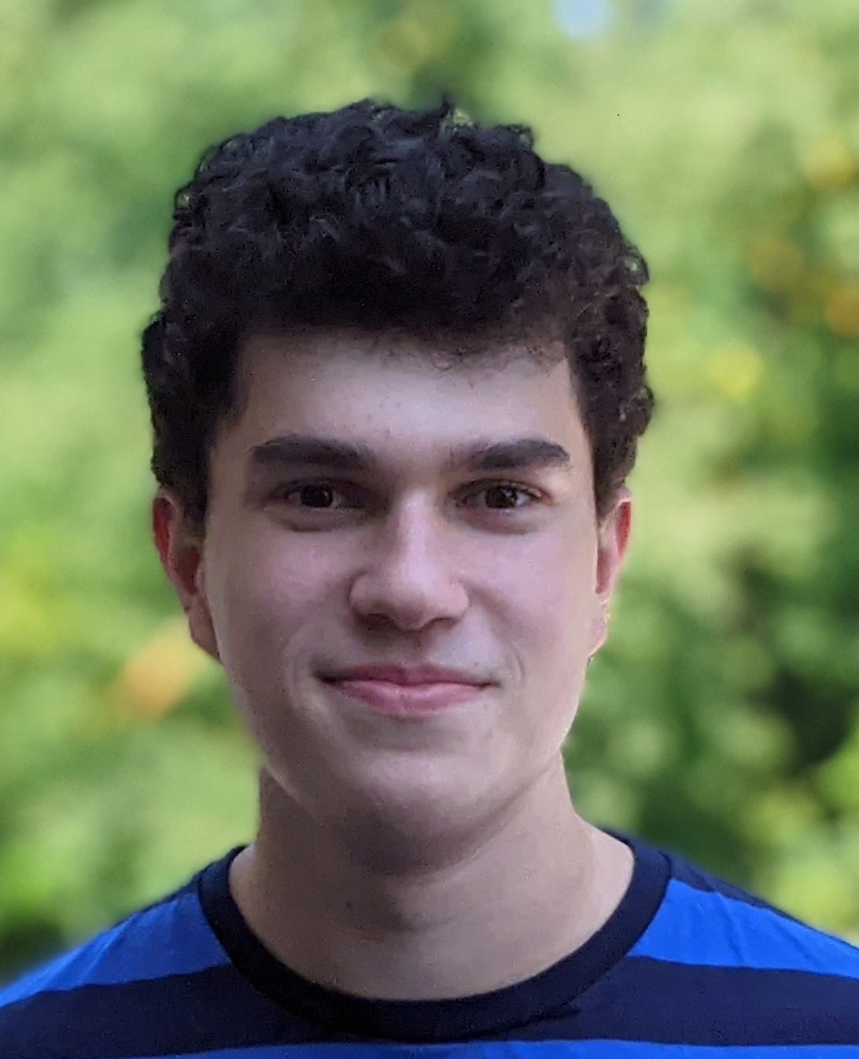
Benjamin Ratin
Team
I am a rising senior high school student in Newton, MA.
I am working on the project on my own.
Notes:
My name is Benjamin Ratin. I am a rising senior in Newton North High school in Newton Massachusetts. I have been working on this project on my own, while I relied on a number of pre-built software to help me along the way.

Slide 4
Goal of the Project
To build a crawler vehicle that can drive autonomously and cover every street in a neighborhood to perform a useful task.
Notes:
The goal of my project is to build a crawler vehicle that can drive autonomously and cover every street in a neighborhood to perform a useful task.

Slide 5
Problems to solve
Street cleaning
Checking for safety hazards
1
3
2
Garbage collection
4
Parking enforcement
Notes:
Today, a number of routine tasks in our neighborhoods are performed by human drivers. Activities like garbage collection, street cleaning, checking streets for dangerously parked cars or making sure the streets are safe after a storm could instead be automated.

Slide 6
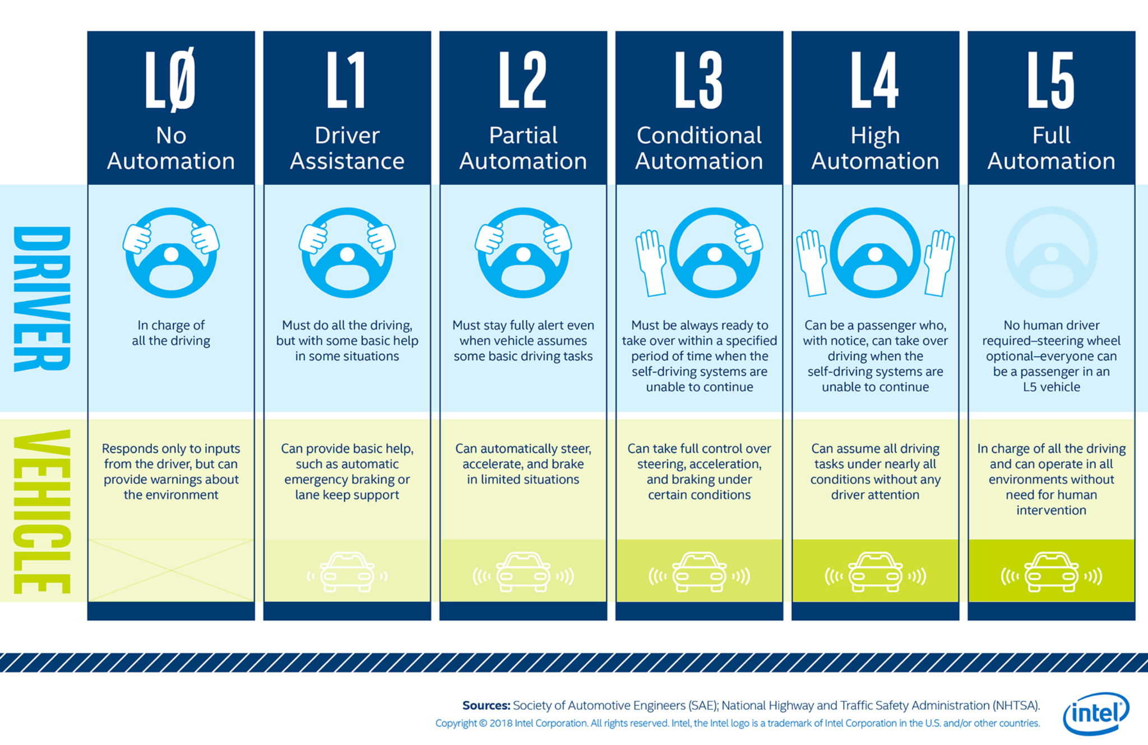
Level of Autonomy
Level 5
Full Automation
Notes:
The crawler has level 5 autonomy, which means it is fully automated and has no human input, other than the initial map. The vehicle is in charge of the routing and driving as well as performing the actual useful task. In my project, I relied on the pre-existing code to handle low-level driving while I focused on higher-level automation routines.

Slide 7


Related Work
Materials from this course
Inspired by the “Interceptor 4” project presented in the first lecture.
Carla simulator, chosen after looking at multiple options
Carla’s Python API, that I am using extensively in my code
Multiple other Python libraries, most notably OpenCV and NumPy
ROS architecture and tutorials (although I did not use ROS directly for this project)
Basic prior knowledge of graph theory
Notes:
Before diving more into technology behind my project, let’s renew some of the related work.
I have relied on the material from this course
The project was inspired by the “Interceptor 4” project presentation that we looked at in the first lecture
I used Carla simulator and Carla Python APIs extensively
I have also used a number of other Python libraries, most notably OpenCV and NumPy
I have looked at ROS architecture and ROS tutorials, although I did not end up using ROS for the implementation of this project
And finally, I used some of my prior knowledge of basic graph theory for the routing algorithm

Slide 8
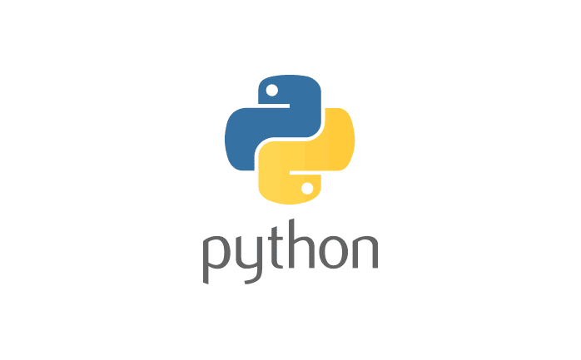





Technology
Software
The logos on the right represent software that I used
Carla documentation
OpenCV documentation
A number of helpful links and tutorials are referenced in the code and the slides above
Some OpenCV functions were originally developed on Ubuntu 20.04
Hardware
Windows desktop, Intel Core i7, 32 GB RAM, NVidia GTX 970 GPU
No robotics hardware - I am using a simulator
Notes:
The other technology that I used are all of the software packages on this slide. I developed the software for this project on Windows using Visual Studio Code. I built everything on my Windows desktop PC that has Intel Core i7 processor with 32 gigabytes of RAM and an NVIdia GTX 970 GPU. I did not use any robotics hardware since I ran everything in the Carla simulator.

Slide 9
Choice of a Simulator
Carla Simulator (https://carla.org/) chosen:
Based on robust Unreal engine
Built-in realistic town maps
Easy to use Python API with plenty of examples
High quality documentation
Existing libraries to assist with autonomous vehicle development (such is low-level driving controls)
Other options considered:
Unity
Gazebo
Notes:
I chose Carla after experimenting with a number of different simulators on Ubuntu and Windows. I liked that Carla has realistic town maps, has a great Python API with preset avatars and high quality documentation. During my research process I also considered using Unity and Gazebo

Slide 10
Features

Slide 11
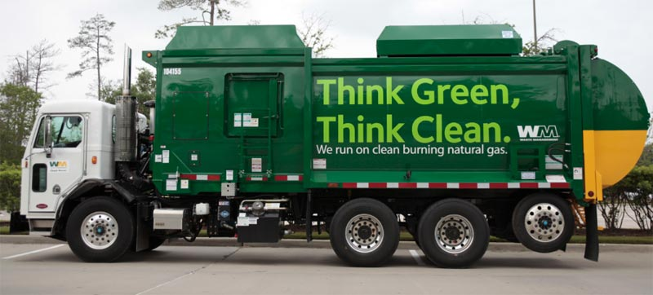
Description
The inputs are:
A map of the area
A task to perform (out of scope of the project)
The vehicle drives over every street on each side based on the map. It obeys traffic laws, although this is largely handled by the simulator libraries.
Addressed challenges (for the rest I relied on Carla):
Route planning to cover all streets and intersections in both directions
Real time visualization of the route in progress
Object detection to help perform the task
Notes:
The vehicle is set up with a map of the neighborhood that needs to be covered. After that, it drives on every street in each direction based on that map. While the low-level driving is handled by the Carla Python libraries, I focused on a few challenges more directly related to my project. I developed a routing algorithm to plan the best route through the neighborhood. I built a real-time map that represents the vehicle’s visualization of the route and current status. I incorporated object detection to identify objects of interest to make driving better as well as to allow for the performance of the actual task in the future.

Slide 12
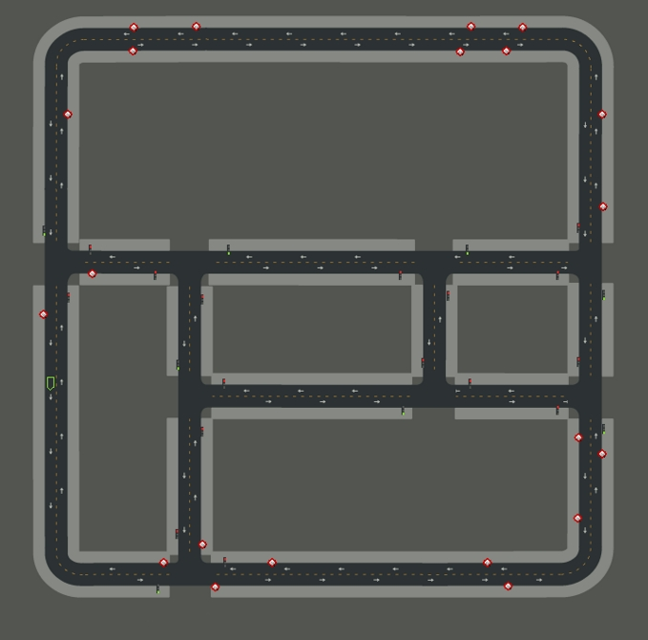
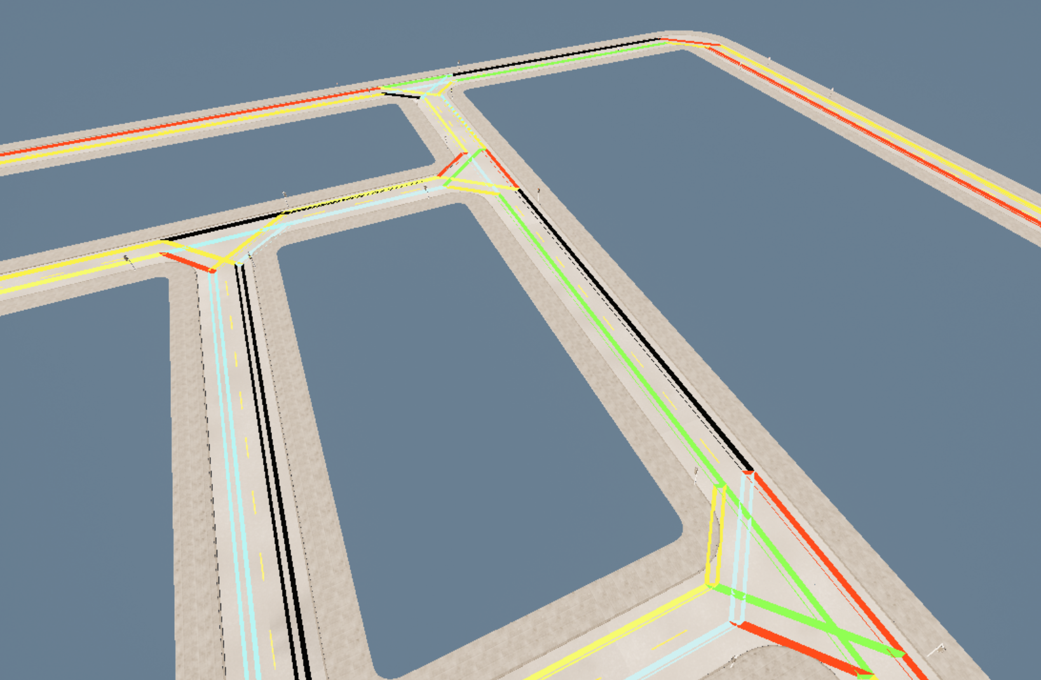
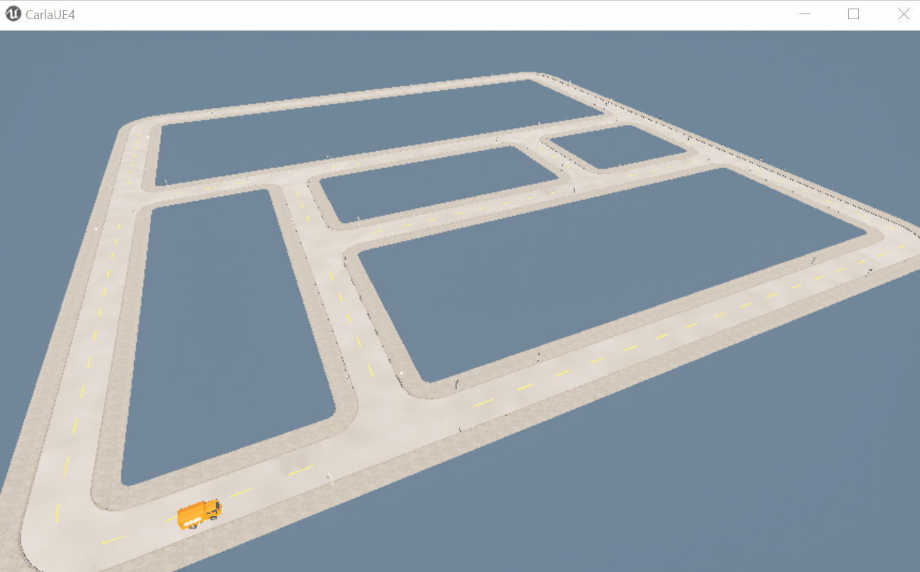
Route Planning
Town02 map from the Carla simulator
Topology from Carla’s Map API
Topology with close Waypoints removed
Find the first Edge that starts closest to the current location
Topology from Carla (colors are to distinguish segments from each other)
Find next Edge with the start closest to the last Edge’s end
List of Waypoints chaining the Edges together
Notes:
My routing algorithm works like this.
I first get topology from Carla API. You can see an example of Carla’s “Town02” map on the top of this slide.
Carla’s representation of topology is a list of pairs of waypoints that are directly connected. If a given street has two lanes, there will be 4 waypoints, 2 on each lane at the ends of the street, connected by two segments. You can see this representation in the second image on this slide.
My next step is to combine waypoints that are close to each other. Carla topology has some waypoints within map centimeters of each other and I do not need that level of precision
I then create a list of edges between each pair of waypoints. The idea is that if I have my vehicle drive along each edge I will then cover the entire map in both directions.
To determine the sequencing, I first find the edge with the start closest to the initial location of the vehicle. Carla’s API has a function that determines how far two waypoints are from each other in terms of the route between them, so I rely on that function to measure the distance.
Once I’ve identified the first edge that the vehicle should drive on, I take the end of that edge and find the next edge with the start closest to that point.
I repeat this process until I have covered all edges. Since edges are directional, meaning that there two edges for each two-way street, once the vehicle has driven over all edges, the entire map will be covered.
Finally, I create a list of waypoints that represent starts and ends of the edges in sequence. I now have my route.
The animated image shows the sequencing of waypoints, starting with the yellow vehicle position in the lower left corner. You can see where the vehicle is planning to drive to while performing its task. At the very end of the animation, you see an edge that connects two waypoints that are not directly connected by a road. The vehicle will need to drive to that waypoint on the right so that it can then cover the two small diagonal segments in the intersection there.

Slide 13
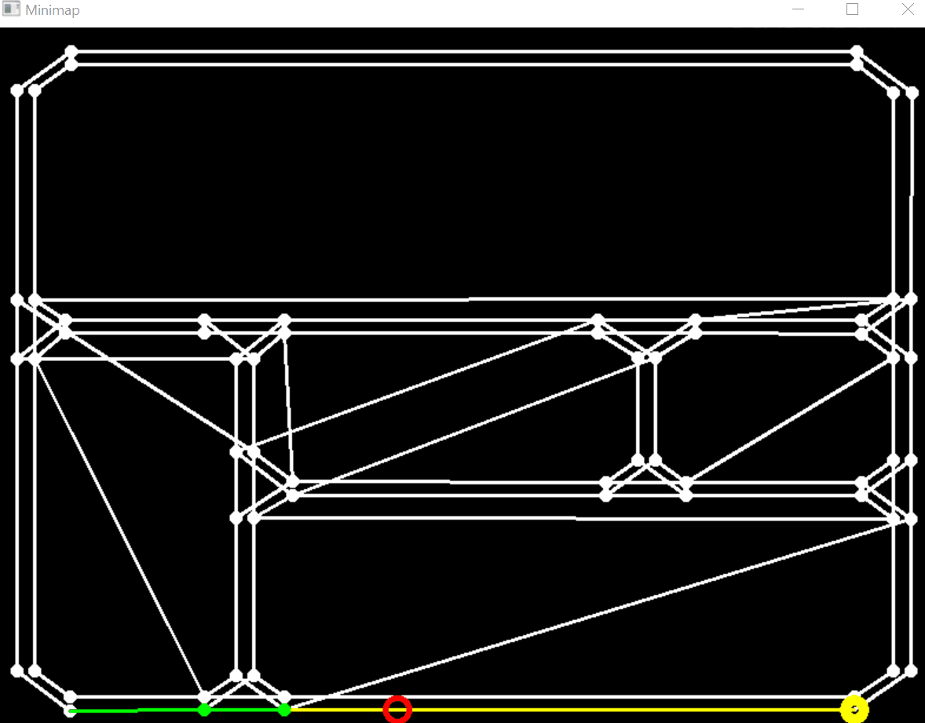
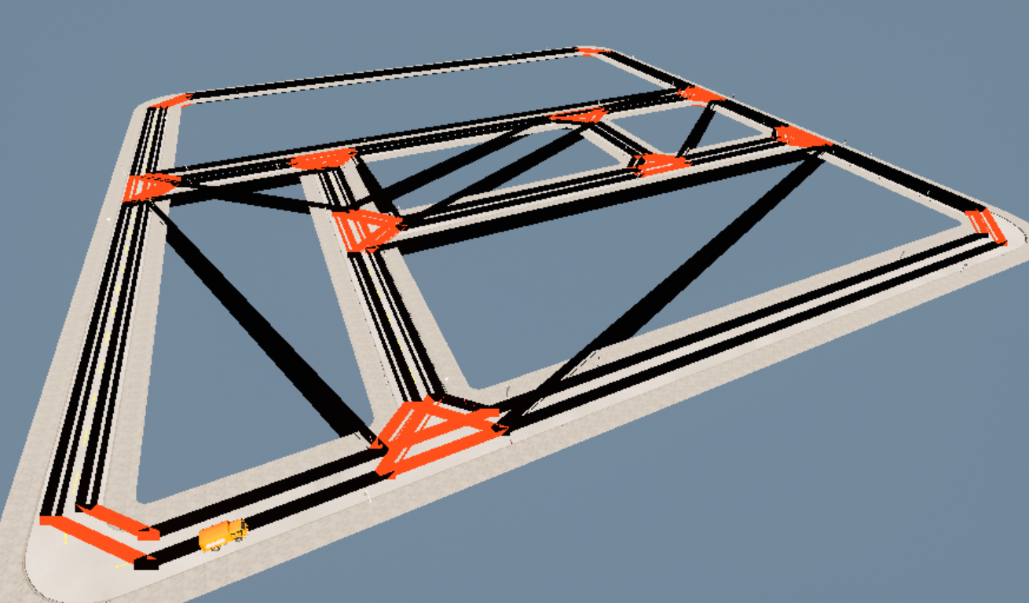
Complete Plan
Town02 map from the Carla simulator
Complete plan with everything covered
Notes:
This is what the route plan looks like after the entire planning process is complete. You can see from the image on the left that I have full coverage of the map. The animated image on the right show the visual representation of this plan within the vehicle’s planner, with the current vehicle position as it is driving around. I will show more of this during the demo shortly.

Slide 14
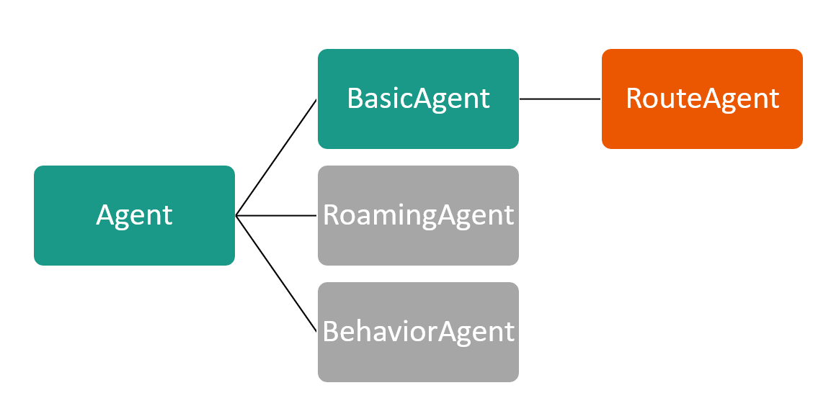
Autonomous Driving
Low-level driving is done by the Carla simulator
I control the destination list based on the computed route
I experimented with lane detection and object detection
Agent - implements common functions for all agents
BasicAgent - navigate scene to reach a specified destination
I implemented a RouteAgent class that can maintain a list of routes and guide its parent class to drive to each destination in sequence.
Notes:
For the low-level driving part I rely on Carla’s Python libraries. The Agent class in Carla represent basic functionality of all Agents that can control actors within the simulation. BasicAgent class, inherited from Agent, and supporting classes implement the ability of the vehicle to drive to a given destination. I wrote a new class, RouteAgent, that inherits from BasicAgent to add functionality such as routing and handling a list of destinations.
== just for the notes
RoamingAgent - makes random decisions at each intersection
BehaviorAgent - allows for controlling behaviors, like aggressive driving, etc. I did not need that for this project.

Slide 15
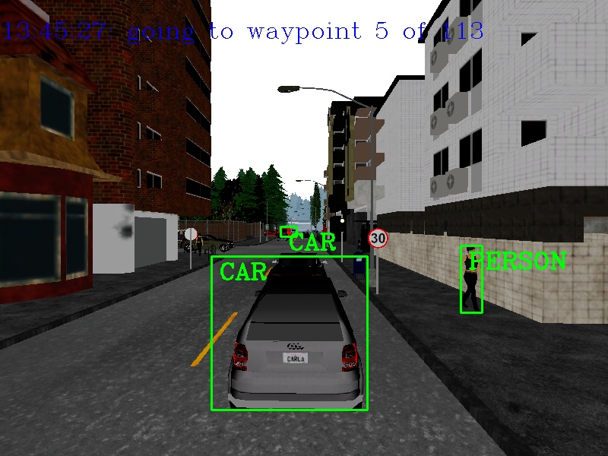
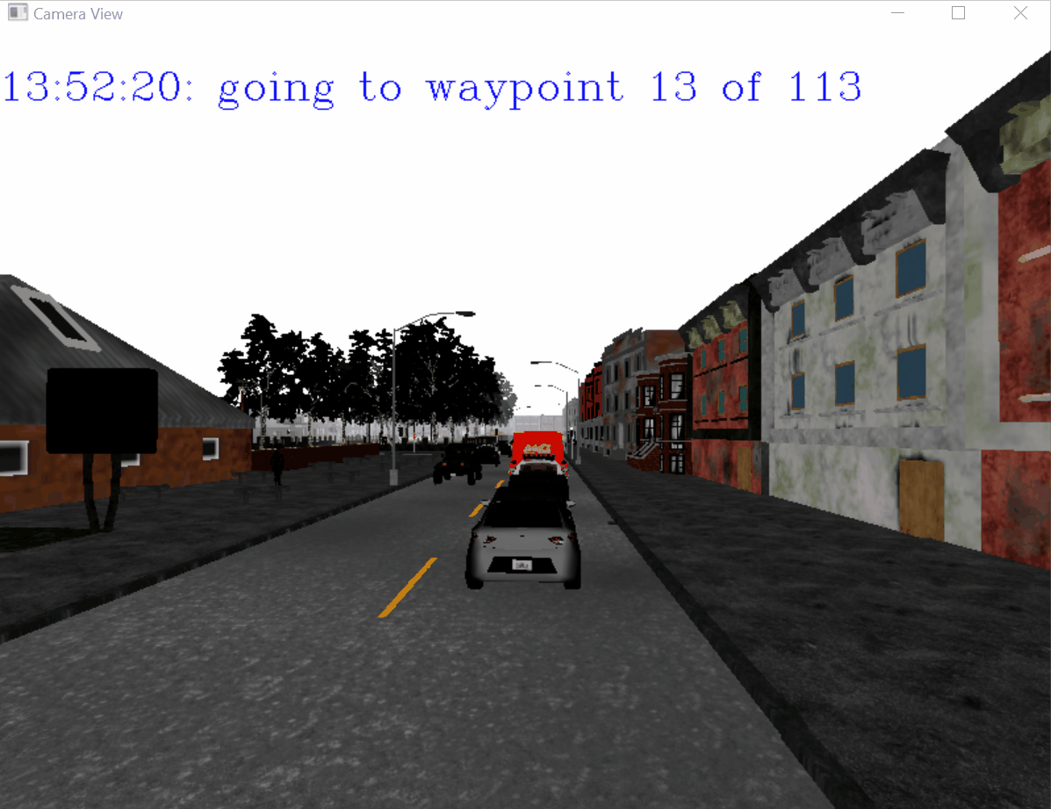
Object Detection
Object detection is required for
driving
performing the vehicle tasks
I am using dnn_DetectionModel method available in OpenCV with a pre-trained model
Allows for detection of basic objects
References: https://www.youtube.com/watch?v=HXDD7-EnGBY , https://github.com/ankityddv/ObjectDetector-OpenCV.git
Notes:
For object detection I rely on OpenCV dnn_DetectionModel API. I found pre-trained models online that allow for object detection in real time. I used Carla’s RGB camera sensor’s output to feed images to the detection API and to overlay boxes on top of the images. I referenced my sources at the bottom of the slide.

Slide 16
Demo

Slide 17
Show Demo

Slide 18
Conclusion

Slide 19
What I Learned From This Project
ROS and Carla architecture
Carla API
OpenCV and NumPy API
Object detection
Graph theory algorithms
Linear algebra
Notes:
I learned quite a few things from working on this project, including ROS and Carla architecture and multiple APIs. I learned more about object detection and I was able to use my basic knowledge of graph theory and linear algebra.

Slide 20
Future Work
Include a task execution, like a garbage bin, parked car, etc.
Improvements to the route selection algorithm
Better training on the object recognition model (on Carla objects)
Object tracking
Real AI driving based on sensors
Use of ROS bridge and open source ROS Nodes
Notes:
I have a lot of ideas about the possible future work. First of all, I need to add an actual task execution. The routing algorithm can probably be improved. I am sure the object detection model can also be improved, especially if I train it on Carla representations of the objects. In addition, I can implement object tracking instead of just recognizing objects independently in every frame. I can also work on using actual AI for low-level driving instead of the existing libraries relying on predetermined waypoints. Finally, I can use ROS bridge to take advantage of existing ROS nodes.

Slide 21
Thank you.
Notes:
In conclusion, this was a great experience. I learned a lot along the way and I am looking forward to learning more in the near future!

Slide 22
Project Schedule
Milestones | Date(s) | Comments
Familiarize myself with robotics development tools, like ROS | 6/22 - 7/10
Pick a simulation engine | 7/3-7/13 | Looked at Unity, Gazebo and a few other options
Setup development environments | 7/3-7/14 | Setup a Windows and an Ubuntu dev environments with all the tools ready
Basic self-driving car using existing Carla tools | 7/16 | Have basics working and going through more complex tutorials
Routing/navigation module prototype | 7/25 | I will start with a standalone set of functions that can plot the route among waypoints
Routing/navigation module fully integrated | 7-29-8/1
Identification of possible improvements to the overall system | Ongoing
Work on the presentation with demo video(s) | 7/28-8/3
Final presentation | 8/5

